Slide 1
Domovoy
Team :- HackSe Single

Slide 2
The Problem
With the present system, House ownership transfer is a long and tedious process.
The owner has to maintain and secure physical proofs of housekeeping / maintenance work done on the house.
Thus no legitimacy to already done maintenance work if the relevant documents are lost.
The house certificates can be easily faked to give wrong insight of the property to a new buyer.

Slide 3

What we have done...
We have created a digital twin or say a digital soul of the house on a blockchain network.

Slide 4

House and renovation details on blockchain network...
The house details with the maintenance history are stored on the blockchain network.
The owner does not have to worry about losing the documents and a new buyer can easily see the house history.
This allows a hassle-free transfer of ownership by just creating a transaction in the name of the new user.
The rights of the house with access to the house wallet will be transferred to the buyer.

Slide 5

Why Blockchain???
Immutability
Security
Legitimacy
Transparency
With the documents stored on decentralised blockchain network, the owner does not have to worry about their safety.
Any attempts to change the documents will generate error, thus blockchain is enforcing immutability.
To verify the legitimacy of the documents, details about the actual money transaction is also stored on blockchain.
An interested buyer can easily see the house history on the blockchain.

Slide 6

An Example of House Ownership transfer ….

Slide 7
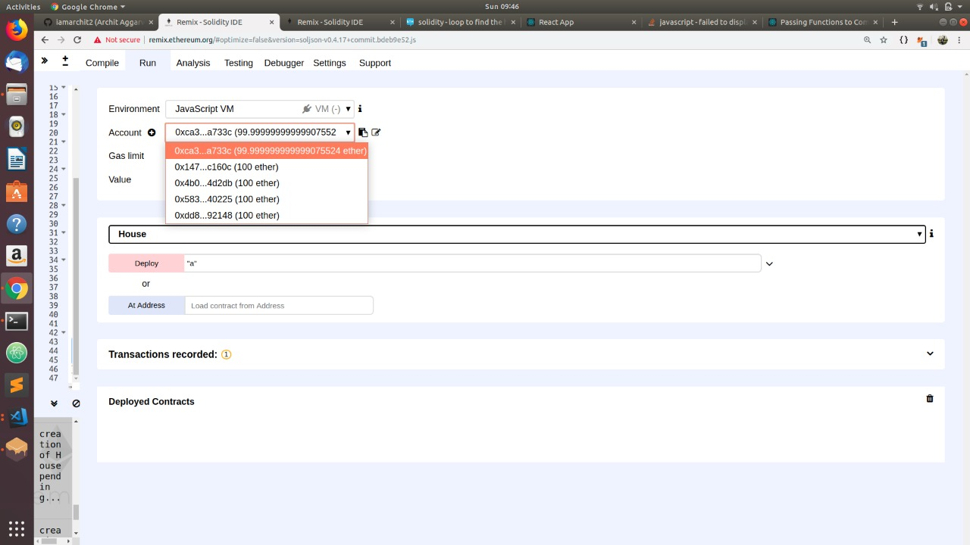
Step 1 : Login to your account

Slide 8
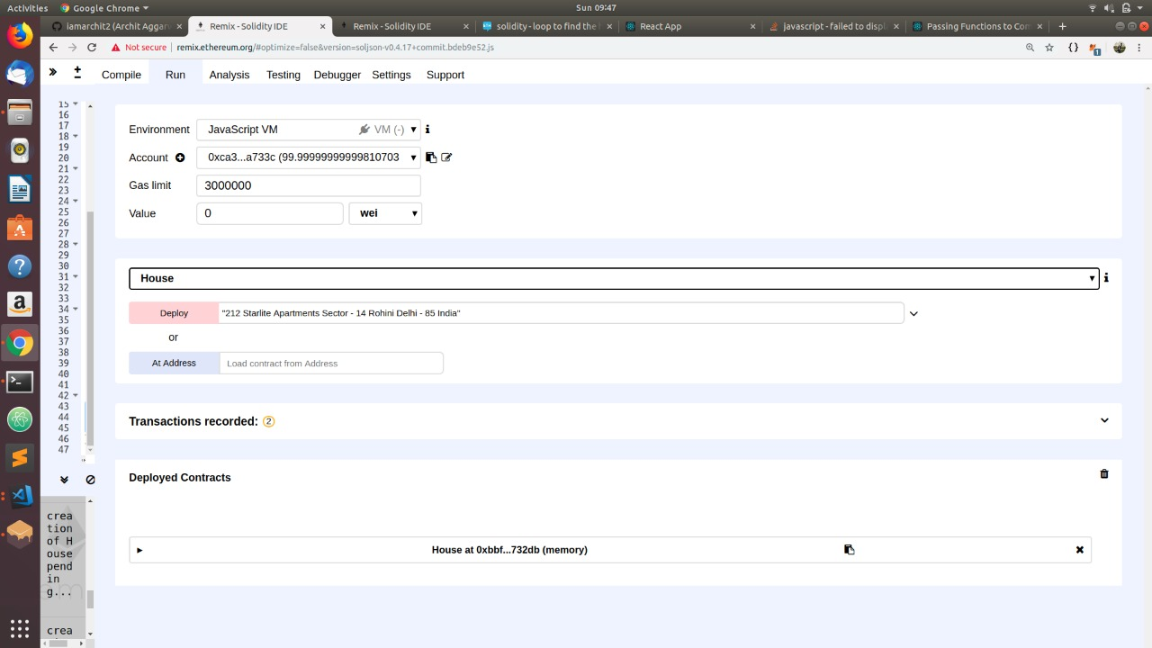
Step 2 : Add your house

Slide 9
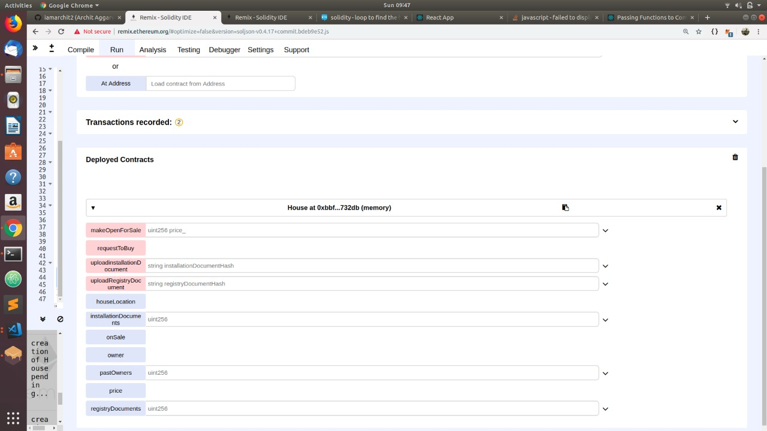
Step 3 : Various house functionalities

Slide 10
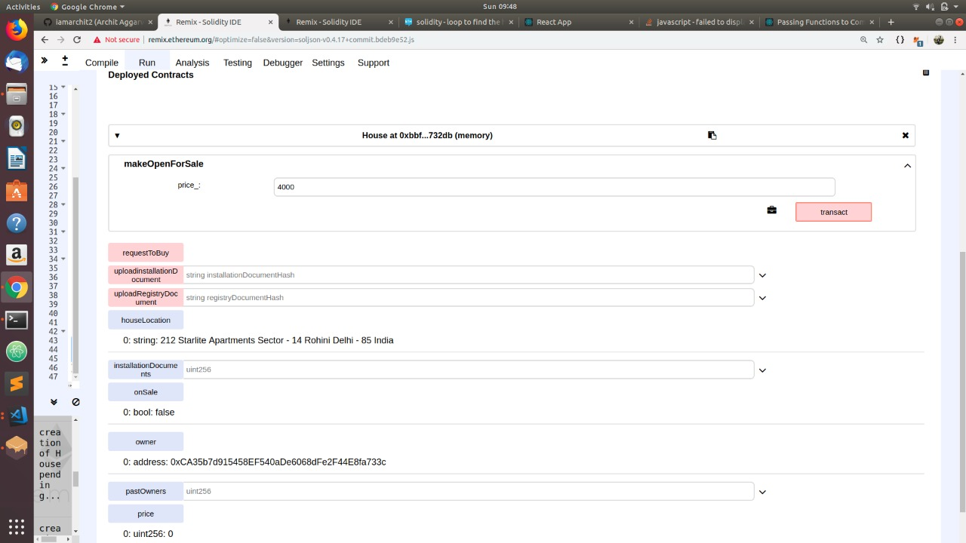
Step 4 : Make your house open for sale with expected price.

Slide 11
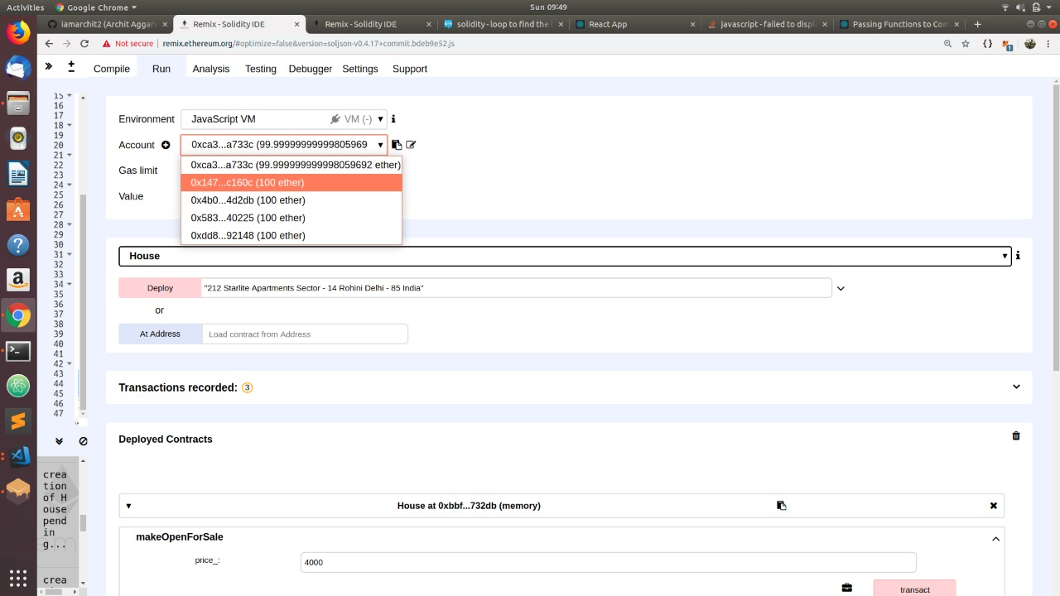
Step 5 : Another user logs in to buy your house

Slide 12
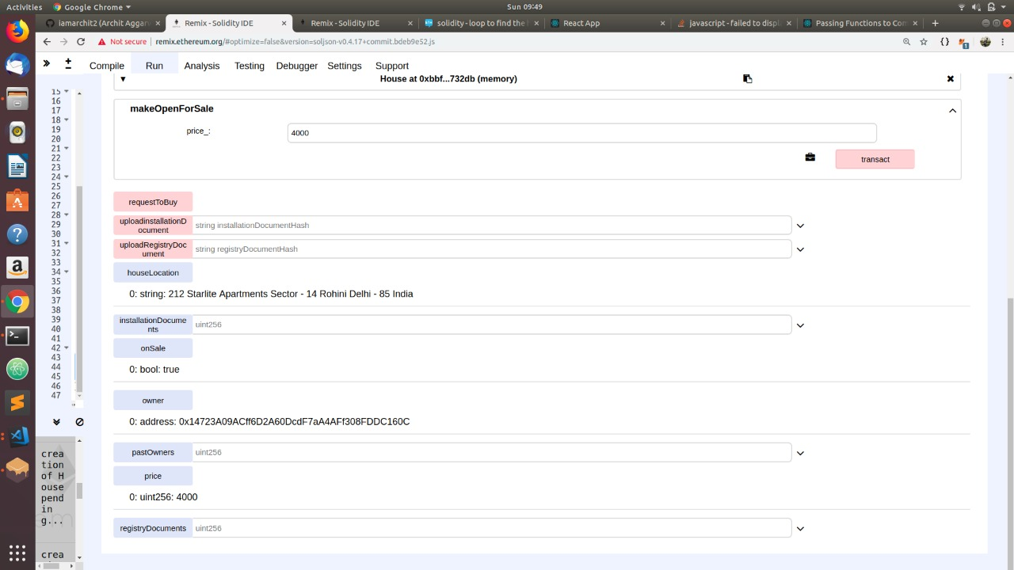
Step 6 : The agreed amount is transferred from buyer’s wallet to seller’s wallet

Slide 13
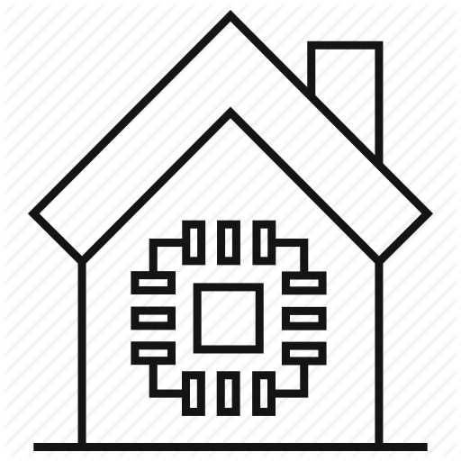
What’s More...
Now the prestige of the house not only depends upon construction but also on how well it has been maintained.
A Machine learning model will predict the likelihood of an appliance failure within the next 30 days.
The owner will be notified if his/her attention is required.
The user can send a service request to a marketplace where certified service providers can bid.
After work completion, the payment details will be stored on blockchain for authentication.
Extremely useful for people who do not live in the house or do not have the time to constantly check for any required maintenance.

Slide 14
An Example of Service Provider….

Slide 15
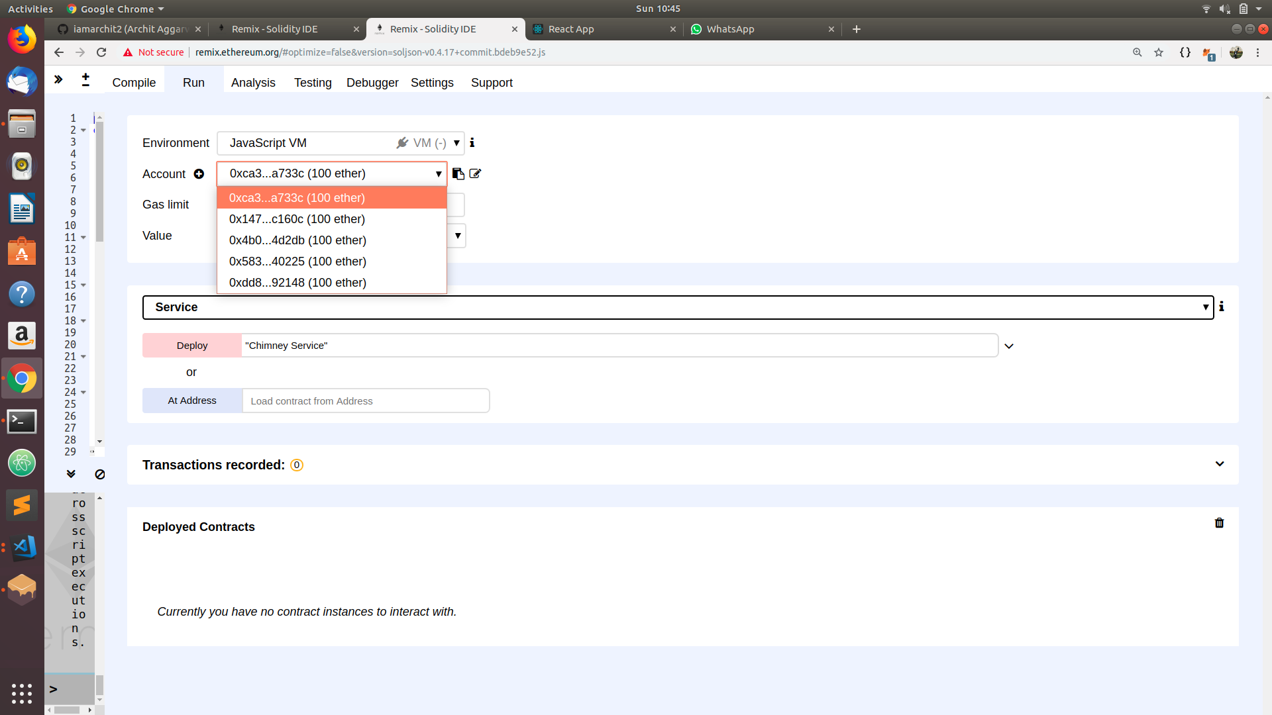

Slide 16
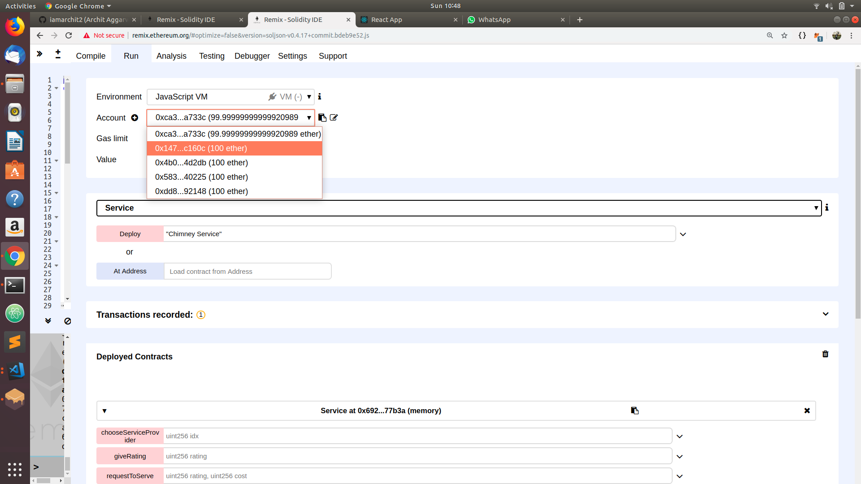

Slide 17
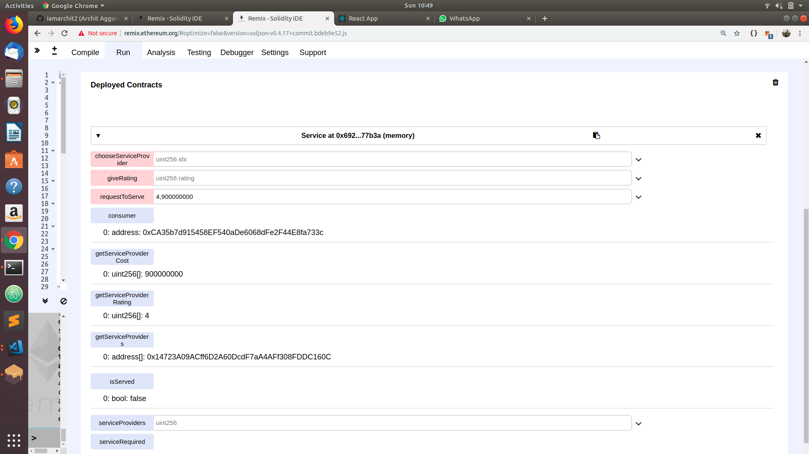

Slide 18
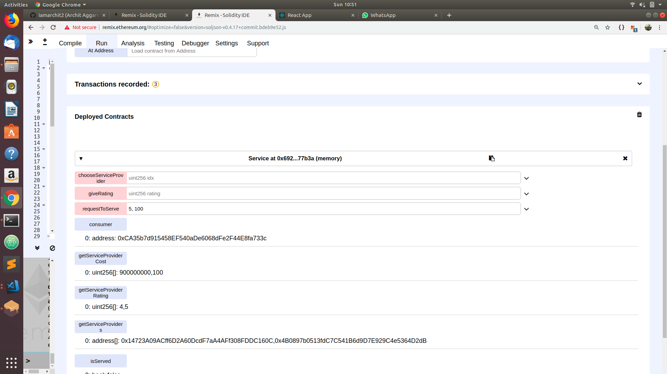

Slide 19
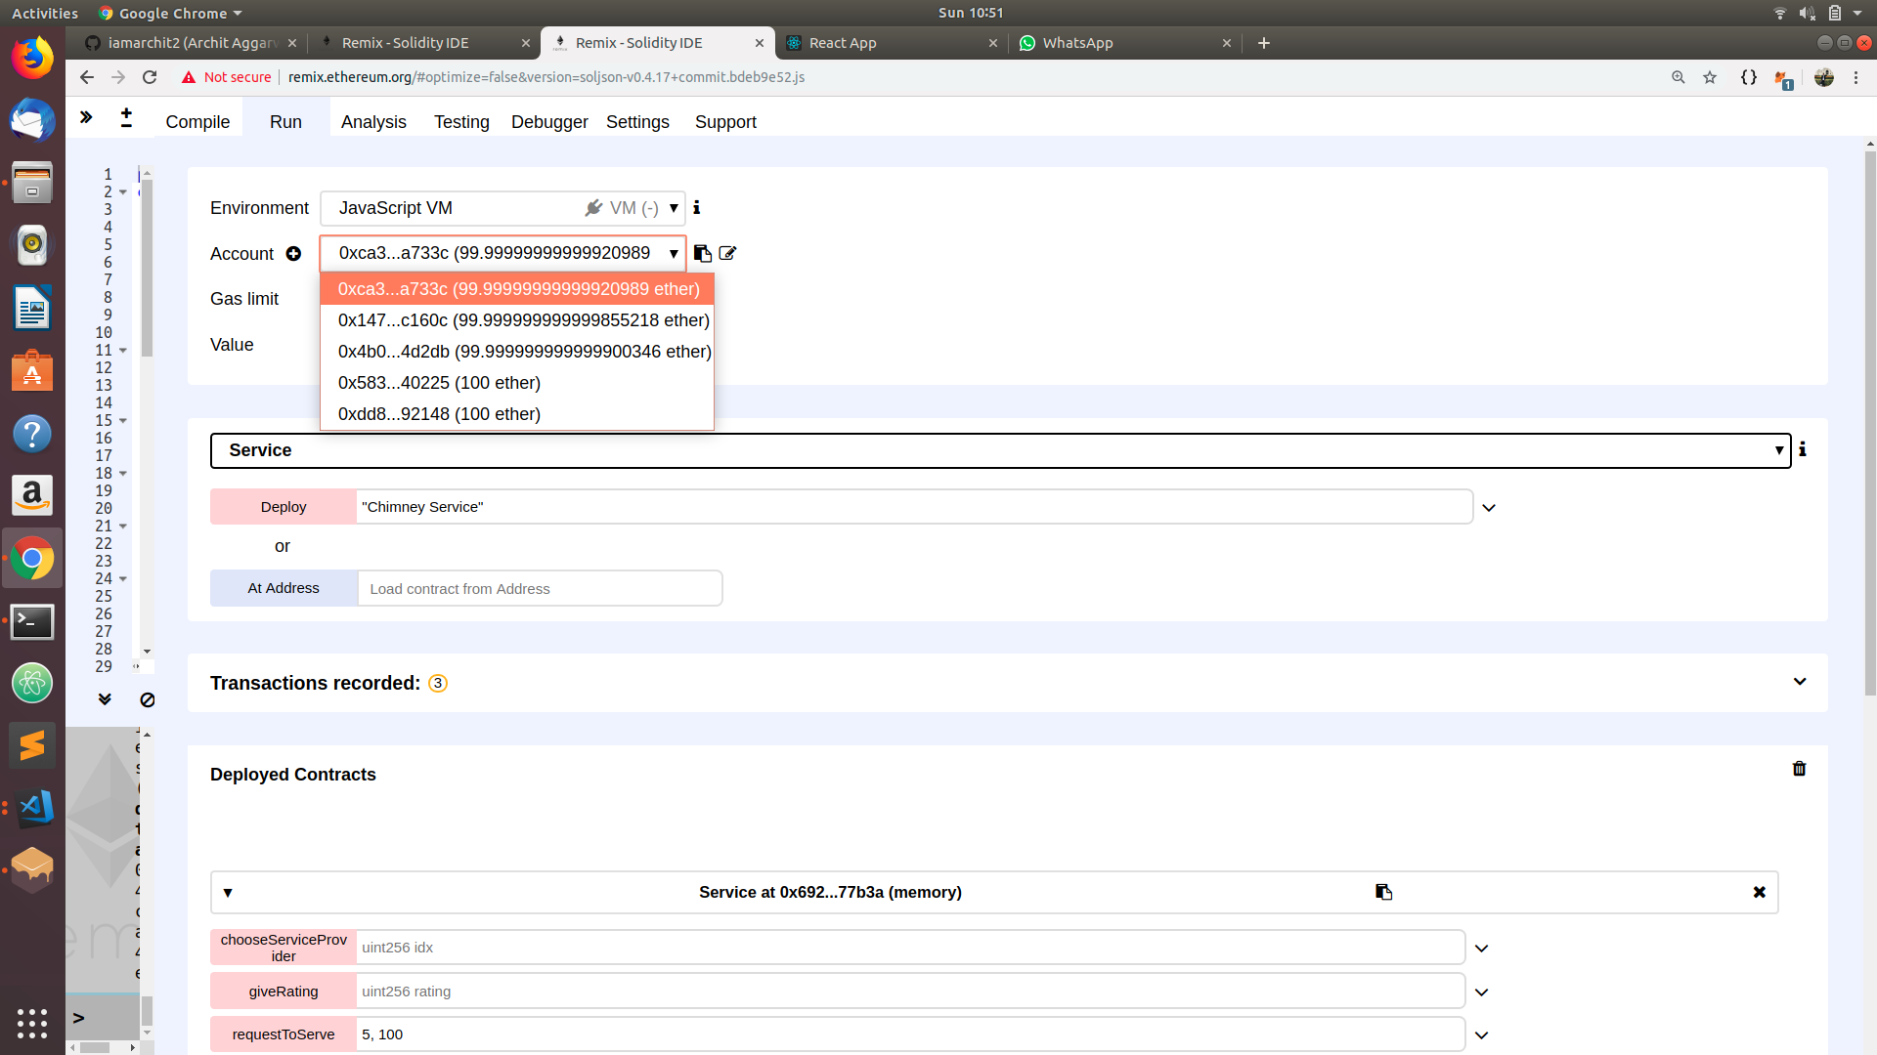

Slide 20
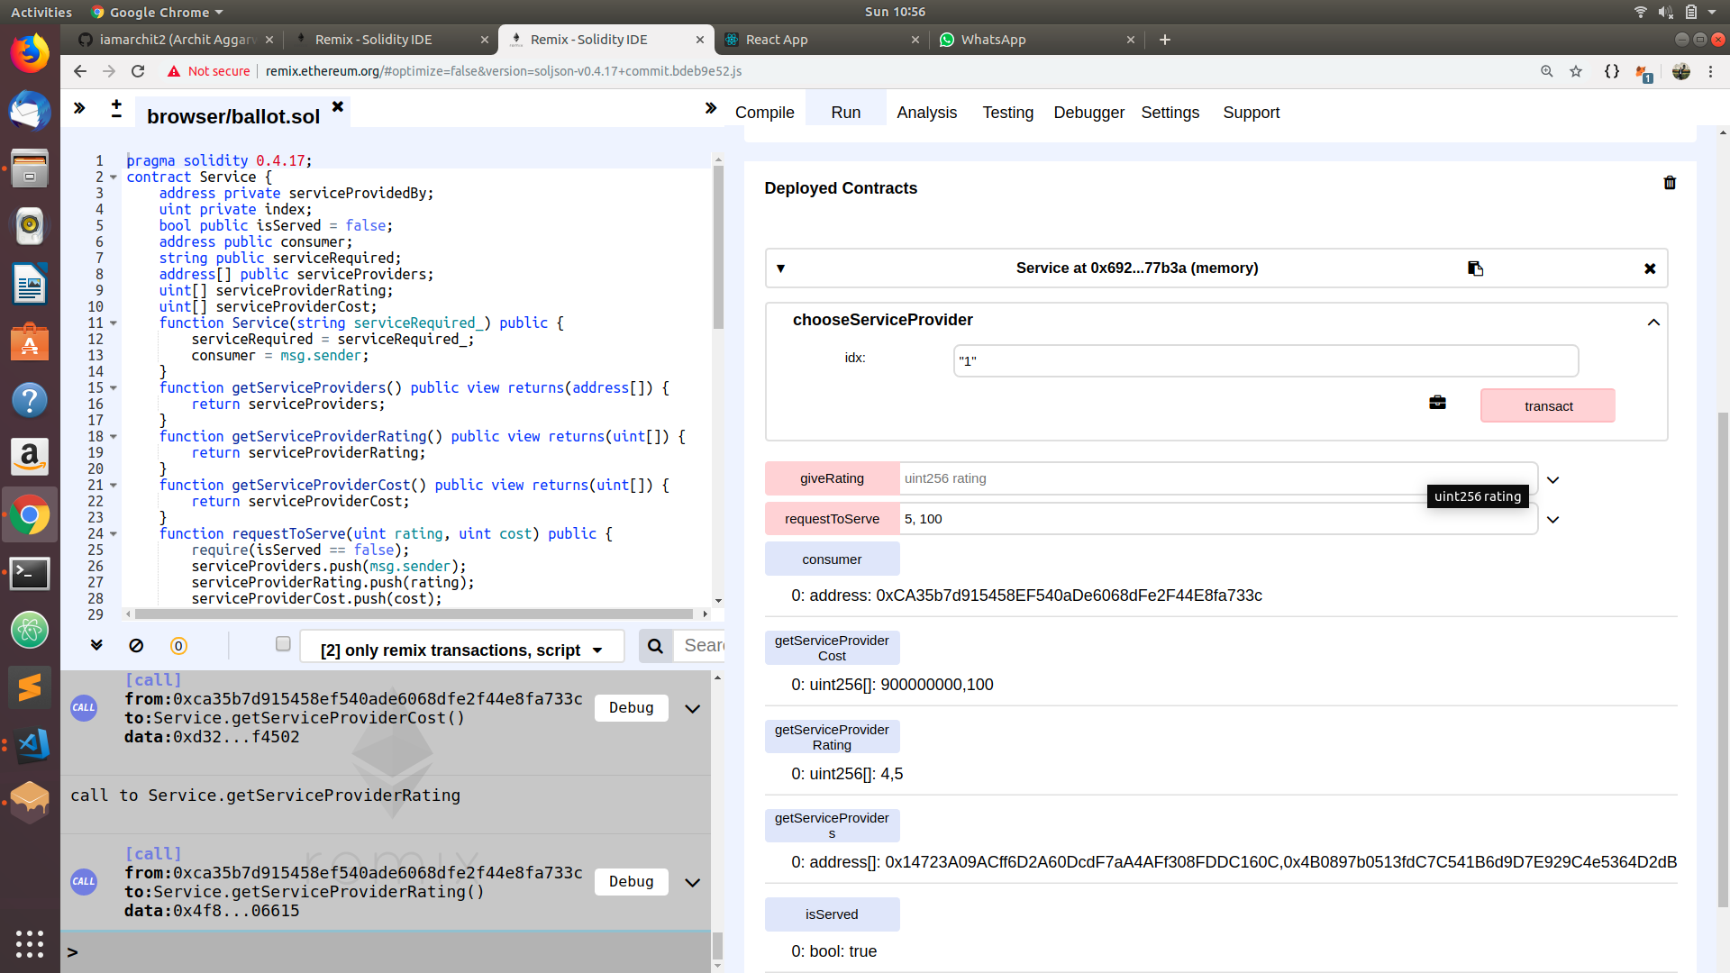

Slide 21
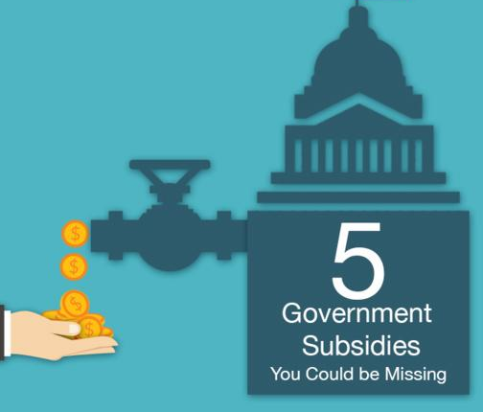
That’s not all...
In the furthur direction to ease the owner , we show him all the govt subsidies that are applicable to his house.
This way the owner does not have to skim through all of them.
The final decision is on the owner to opt for a subsidy.
A recommender system will tell which of the applicable schemes are best suited for the owner according to his customisations and other similar choices.

Slide 22
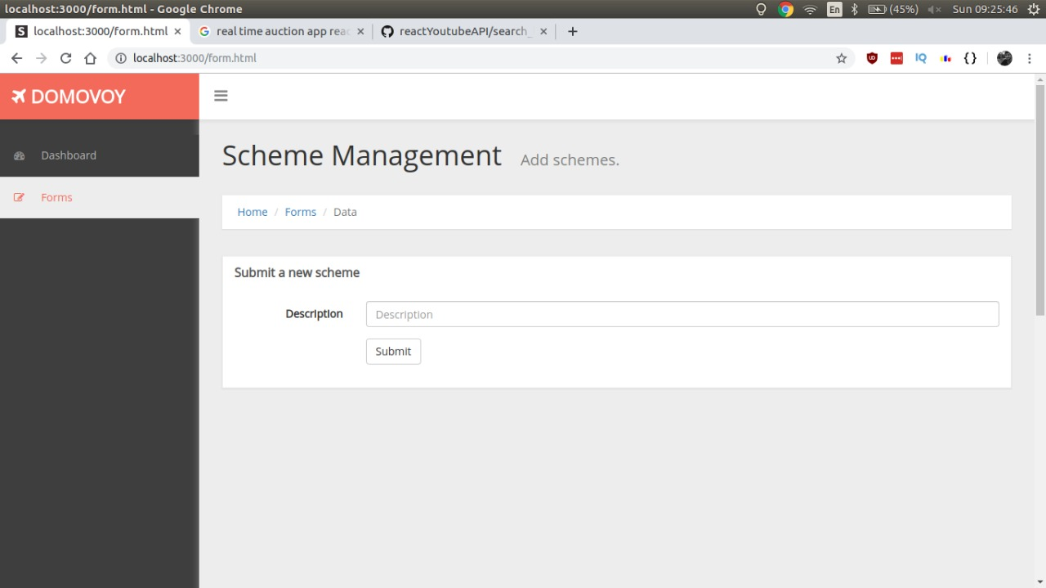
Schemes will be added using this portal

Slide 23
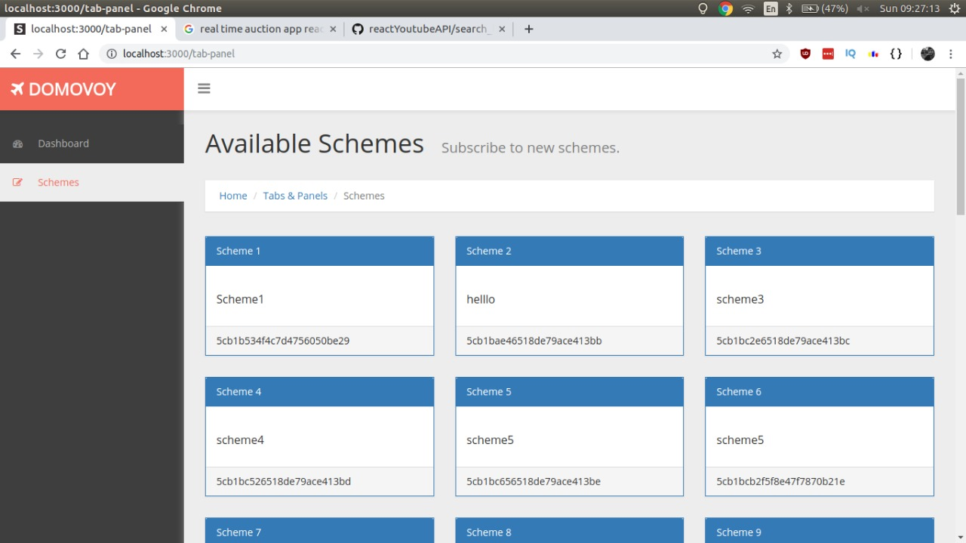
The user sees schemes applicable to his house

Slide 24
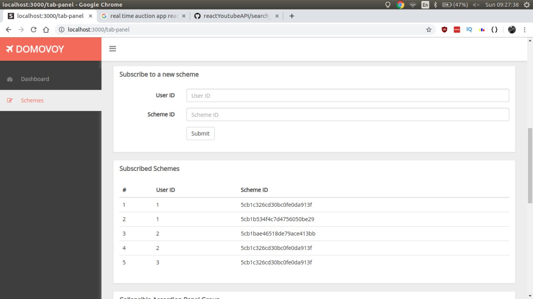
The user can apply to a particular scheme ….

Slide 25




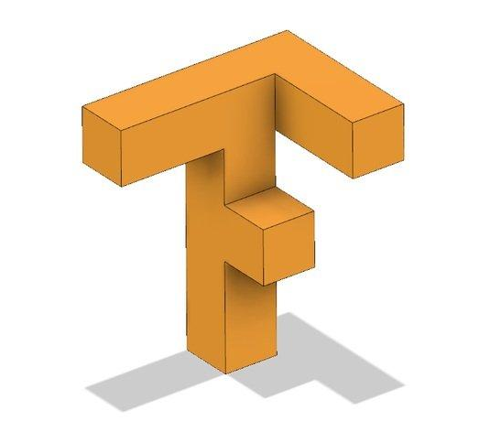
Technologies Used ...
1.
Ethereum is used to build the blockchain network.
Programming language for writing smart contracts for the ethereum blockchain
2.
Ethereum Blockchain
Solidity
Metamask
NodeJs
Tensorflow
Data mining
MetaMask is an extension for accessing Ethereum enabled distributed applications, or "Dapps" in the browser.
3.
NodeJs is used to integrate all the various components and make a central web server.
4.
5.
Tensorflow is used to train LSTM model for predicting appliance failure (in 30 days) probability

Slide 26
Future Plans...
To provide the govt. with the demographic distribution of popularity of various schemes.
To generalise the above concept to every type of property.
To make a reminder system that keeps check of the expiry dates of various house documents and notify the user if their expiration date is near and need renewal.
To keep check if none of the mandatory govt. rules are violated.
To also include renting aspect of the property.
To successfully implement and organise this system in countries like India which has a highly unorganised real estate sector and not having proper implementation of rules.

Slide 27
Our team
Archit Aggarwal (Blockchain)
Ishank Jain (Blockchain)
Nipun jain (Data mining)
Sudhanshu shah (Web developer)
Yash Agarwal (Machine learning)

